Slide 1
Struct-LSTM Structure Augmented Long Short-Term Memory Networks For Music Generation
Shakeel Raja
https://github.com/ShakeelRaja/Structured-Augmented-LSTM

Slide 2
Deep Learning and Generative Arts
Generative arts are seen as an intersection of art, creativity and technology to create autonomous system.
A creative autonomous system is non-human and can independently determine features of an artwork that would otherwise require cognitive decisions made directly by the artist.
Deep generative models have been successfully used for modelling languages, speech, images, video and music (unstructured data) in an attempt to understand and model human-like cognitive abilities towards these fields of arts.
Deep Learning techniques have demonstrated encouraging results when applied to the domain of generative arts.

Slide 3
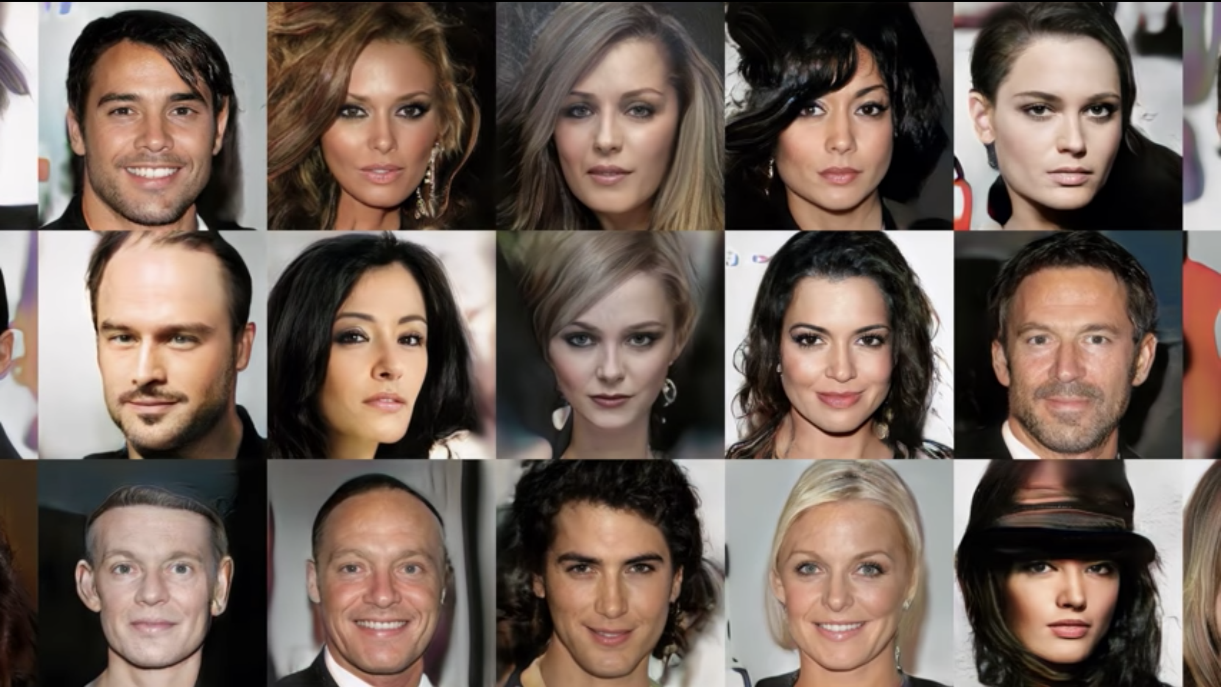
Nvidia’s AI Face Generator https://www.thispersondoesnotexist.com/
https://syncedreview.com/2019/02/09/nvidia-open-sources-hyper-realistic-face-generator-stylegan/

Slide 4
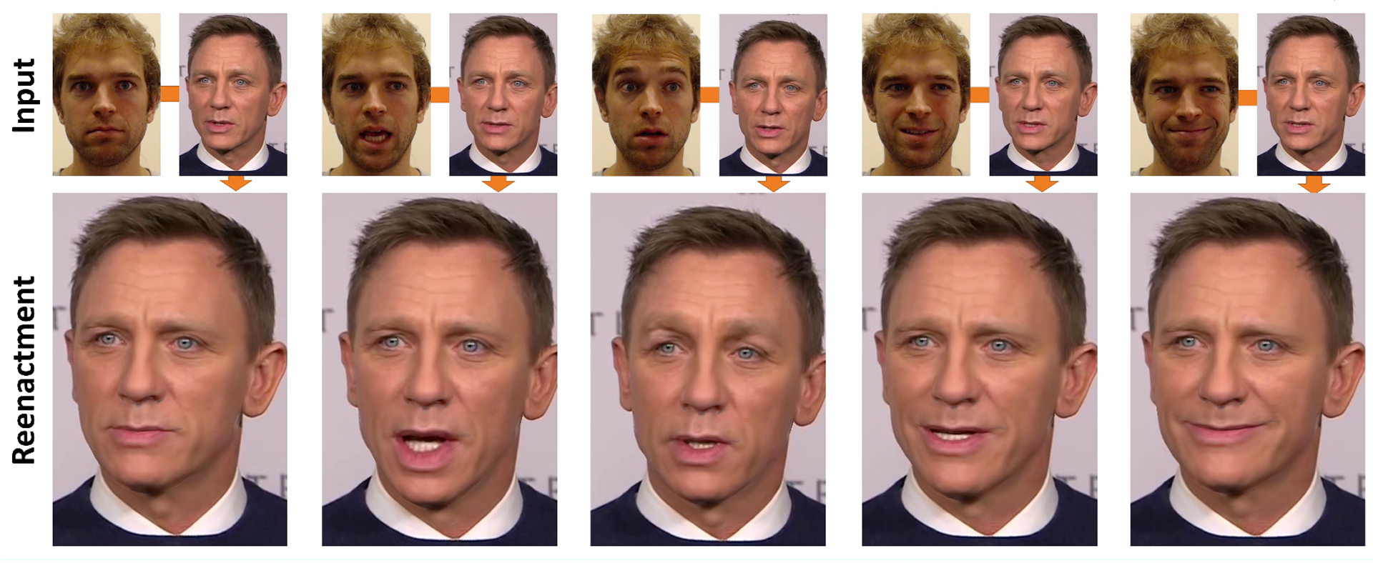
Face2Face: Real-time Face Capture and Re-enactment of RGB Videos
https://web.stanford.edu/~zollhoef/papers/CVPR2016_Face2Face/paper.pdf

Slide 5
OpenAI's ‘Deepfakes for text'
Input for conditioning: Hillary Clinton and George Soros ...
Model output: ... are a perfect match, and their agenda appears to be to create a political movement where Soros and his political machine and Clinton are two of the only major players. This is the first time Soros and Clinton have been caught on tape directly colluding in promoting the same false narrative. ...
https://openai.com/blog/better-language-models/

Slide 6
Music Generation
Considered to be the most challenging AI task as it involves complex cognitive processes towards:
Pitch detection
Rhythm detection
Structural inference
Resulting subjective interpretation
As these processes are not fully understood, they are extremely hard to model in a computational framework
Learning music rhythm and structure during training and demonstrating human-like understanding of musical structure towards composition is a highly challenging task and a rich area of research in music informatics.

Slide 7
OVERVIEW OF MUSIC GENERATION TECHNIQUES
Rule Based Systems
Symbolic in nature (human readable), having explicit rules and well defined structural constraints to control the output of the model in the form of a knowledge base.
Increased level of complication towards knowledge elicitation, a high dependency on the skills of experts for encoding rules into models.
Markov Models
Perform transitions in discrete time steps with a lower level of complexity. Can be effectively utilized within real time music generation applications.
Output highly similar to training data.
Can grow computationally expensive with large amounts of data.
Evolutionary Algorithms
Inspired by evolutionary biological principles, work with large search spaces and provide multiple unique solutions
Output lacks any subjective elements

Slide 8
OVERVIEW OF MUSIC GENERATION TECHNIQUES
Musical Grammars
A Musical Grammar is a set of rules that governs musical structure by expanding high level symbols into detailed sequence of melodies following GTTM (Generative Theory of Tonal Music) by Fred Lehrdal and Generative grammars by Noam Chomsky.
Computationally expensive, encoding music theoretic concepts.
Neural Networks
Following motivation from biological brain, NNs are massively parallel distributed processor made up of simple processing units, which has a natural propensity for storing knowledge and making it available for use.
NNs can be trained on complex structured musical patterns and generate melodic content with improved structure, better control over model definition and generation processes, realistic improvisation and higher flexibility.

Slide 9
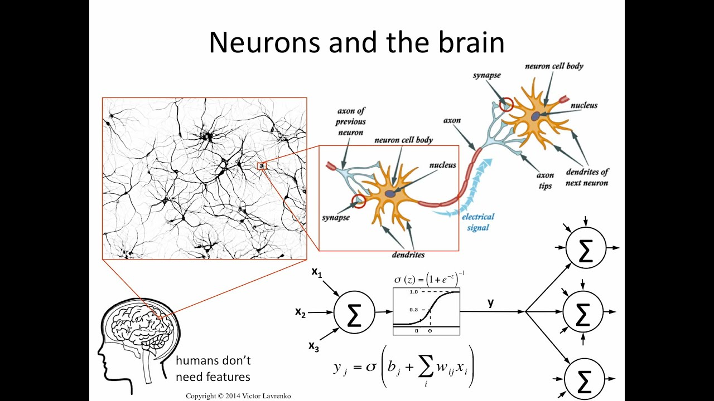

Slide 10
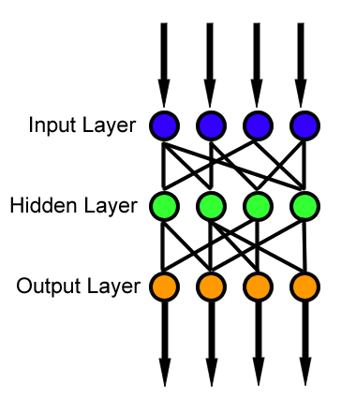


FFNNs vs RNNs vs LSTMs

Slide 11
Examples: Deep networks for music generation
Mozer’s RNN (1994)
https://soundcloud.com/machinelearningmusic/after-bach-by-michael-c-mozer
Doug Eck (2002) – First Use of LSTM
https://soundcloud.com/machinelearningmusic/lstm-blues-improvisation-composition-4-by-doug-eck
BachBot (2016) – LSTMs for adding harmonization
https://soundcloud.com/bachbot
Google Magenta (2016) – Performance LSTMs with event timing and dynamics control
https://soundcloud.com/machinelearningmusic/performance-rnn-by-magenta

Slide 12
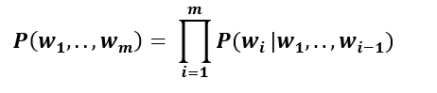
Music Language Modelling
The problem for predicting the probability of a musical event occurring can be titled as a “Sequence Learning Problem” i.e. learning temporal dependence between observations
Music can be seen as a set of events with each event drawn from a vocabulary of finite elements (notes), very similar to a language syntax .
Language Modelling, an NLP technique can be used to represent music in a computational framework.
This describes the likelihood of a musical event 𝒘𝒊 from a finite vocabulary m, given all previous events 𝒘𝟏,..,𝒘𝒊−𝟏

Slide 13
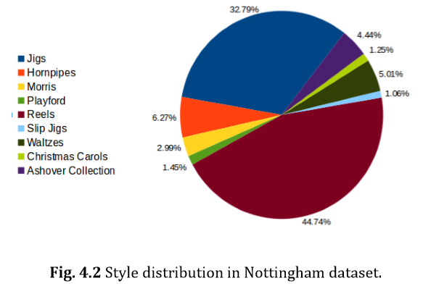
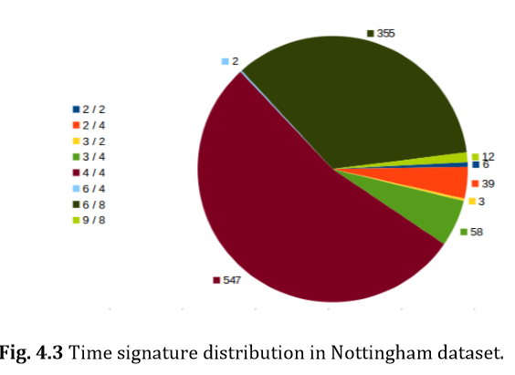
Nottingham Folk Music Dataset
MIDI Files in the dataset contain 3 tracks with track 0 containing song meta information, track 1 and track 2 with temporally relevant musical notes, i.e. melodies in track 1 correspond directly to harmony data in track 2.

Slide 14
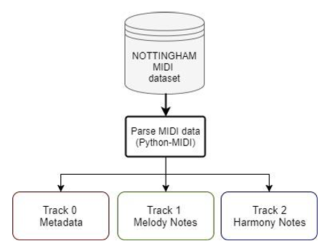
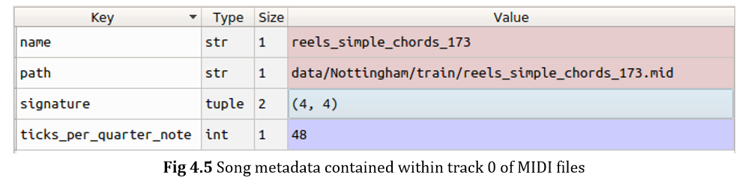
Data Parsing
The code uses a time step of 1/16th of complete note length based on MIDI resolution (i.e. quarter of a quarter beat).
Numpy for parsing and storing meta information
Python-midi for parsing melodies
Mingus for parsing harmonic content

Slide 15
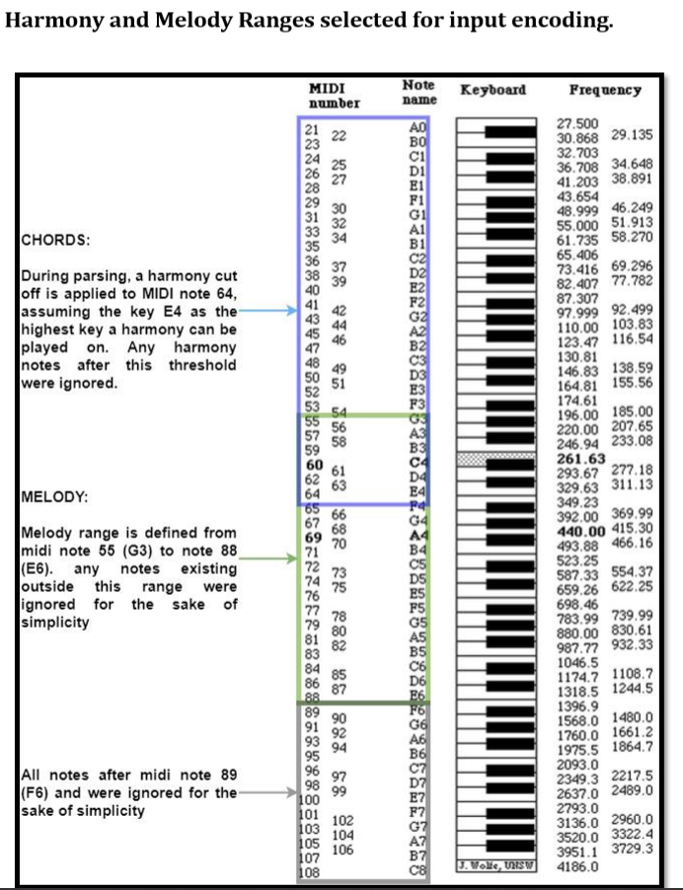

Slide 16
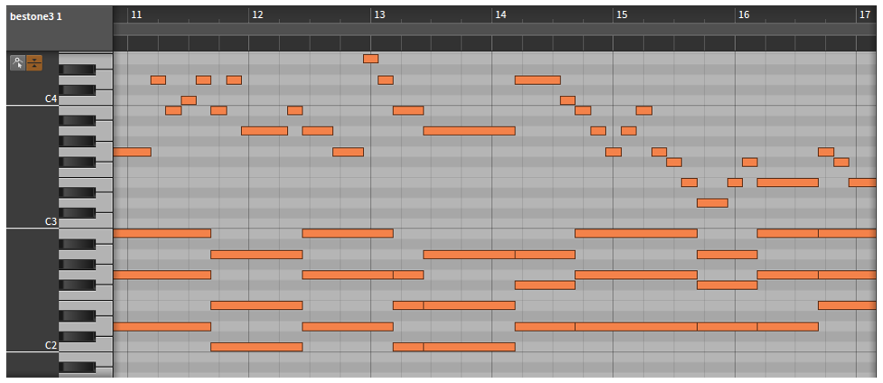
Representation Input Sequences
A piano roll representation for language modelling

Slide 17
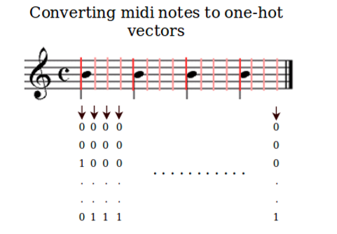
Melody Encoding
Using a 35 bit one hot vectors to represent the melodic content at a given timestep ( Assuming only one melody note is played at any given time step)
This simplified example described parsing of melody track with discretized values taken at 1/16th of a measure (1/4th of a quarter beat in 4/4 format).

Slide 18
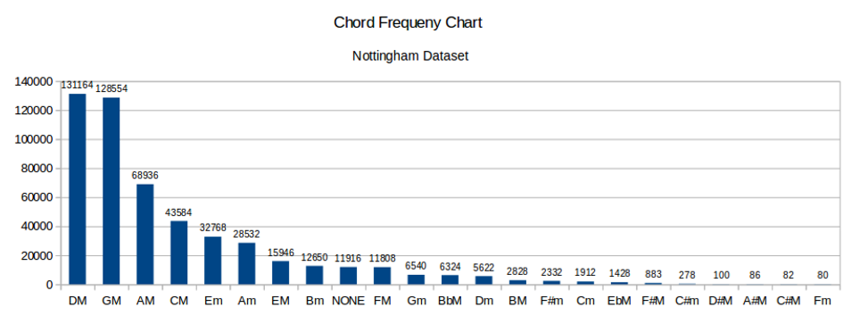
Harmony Encoding
Python Mingus Library is used to identify each chord type.
For simplicity, extended chords including 6th, 7th, 9th, 11th and diminished are converted into respective major and minor chord.
A second one-hot vector is created for each timestep to represent harmony content.

Slide 19
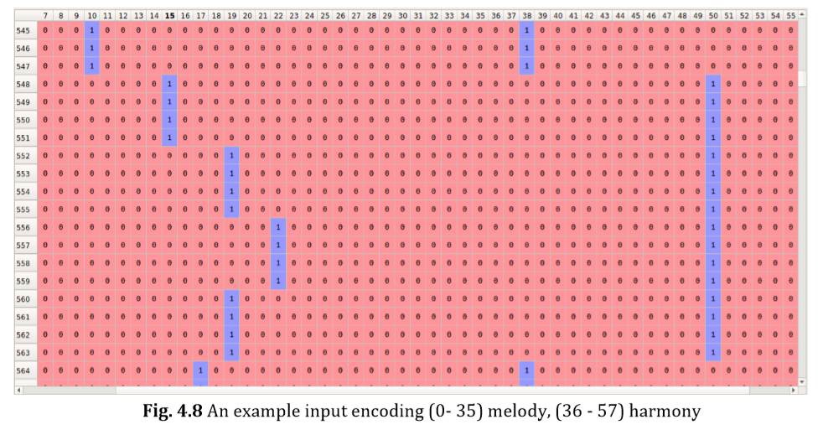
Input Encoding (Base Model)
The MIDI to piano roll mappings were created by appending melody and harmony one hot vectors on each time step and thus creating a final melody encoding.

Slide 20
Augmenting Engineered Features
Structural information as extra input features is appended to input encoding created for baseline model.
Song duration counter: The counter values were set to start with a value equal to number of total time steps in the sequence, and decrement with each step until the last time step, where counter value reaches zero. In other words, it “counts down” to the song conclusion.
Motivation: intro and outro of western music normally consist of chorus and are generally very similar in terms of structure and notes played.
Metrical Information (beat counter): Metrical information was augmented to the input encoding. This involved creating two one hot vectors, first to count each time step towards a quarter beat (4 time steps), and a second counter to count quarter beats up to whole bar (16 time steps or 4 quarter beats).
Motivation: The song metre, associated with recurring patterns of note combinations in musical bars are known to have a strong impact on listener’s perception of the music being played.

Slide 21
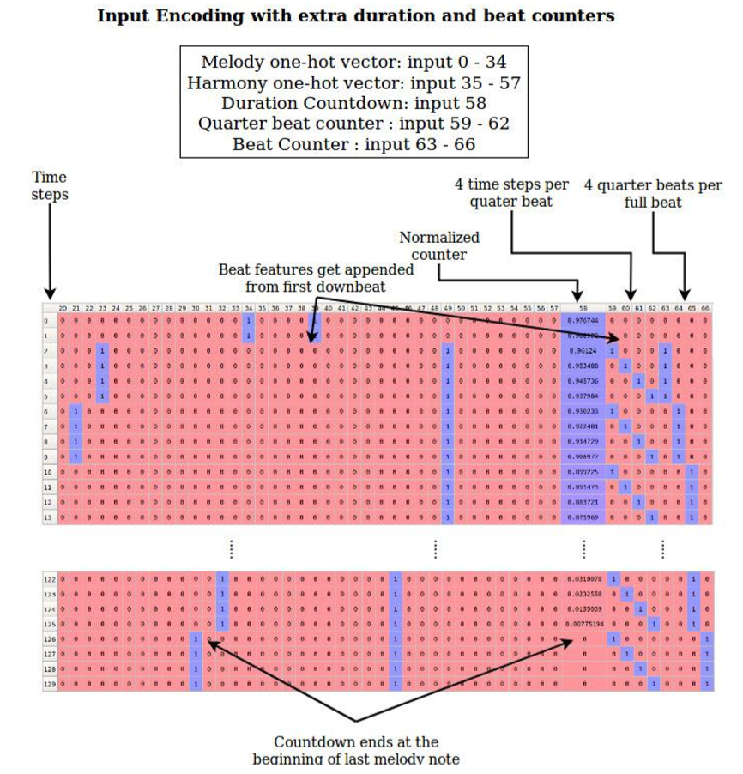

Slide 22
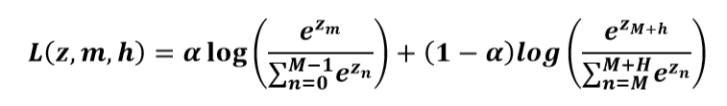
Loss function
For the loss function of the base model uses a weighted sum of melody and harmony log loss ({0,1}).
Here M and H are melody and harmony class. The function calculates the log loss at a time step for the output layer z ∈ R ^{M+H}, a melody label class m, and target harmony label class h. α, termed as melody coefficient, can be altered to shift the focus of loss function between memory and harmony. For the experimentation, α was set to 0.5, giving equal importance to individual melody and harmony losses.

Slide 23
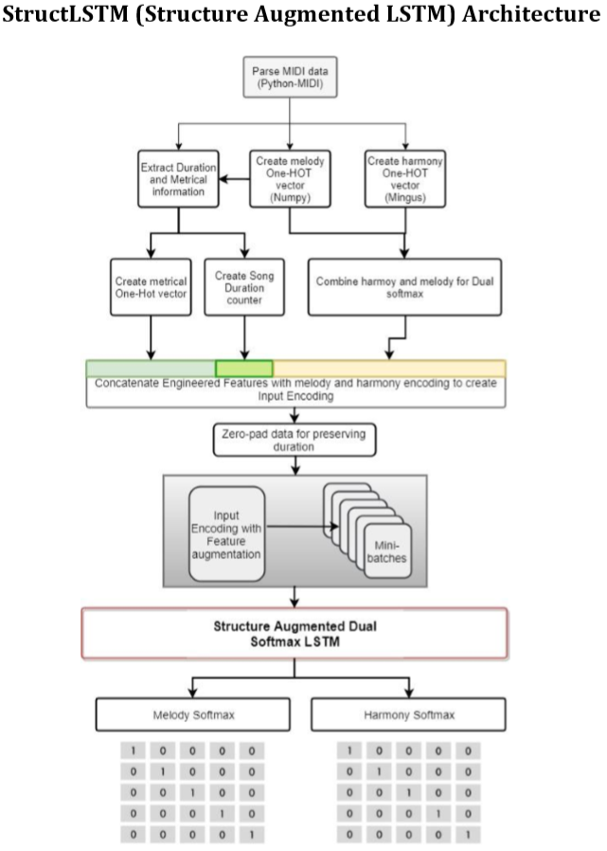

Slide 24
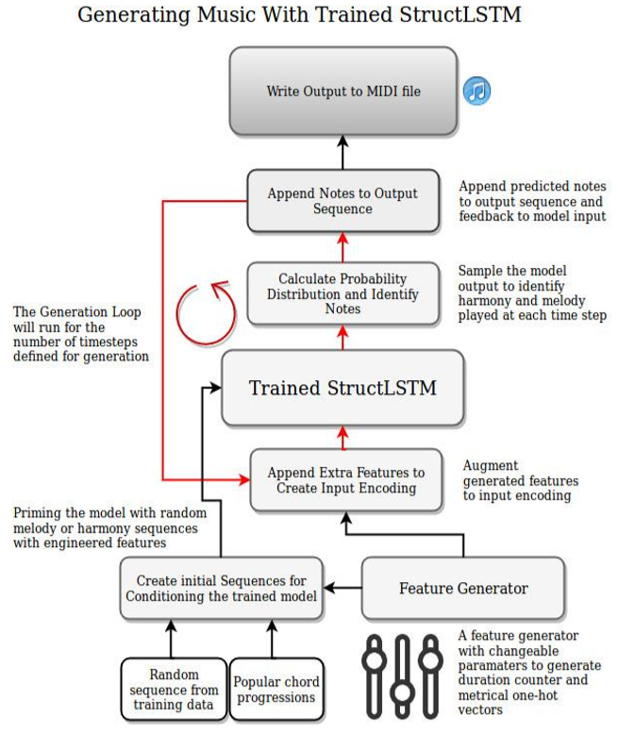
Generation Strategy
Generation approach uses “conditioning” and “sampling” techniques to generate new sequences

Slide 25
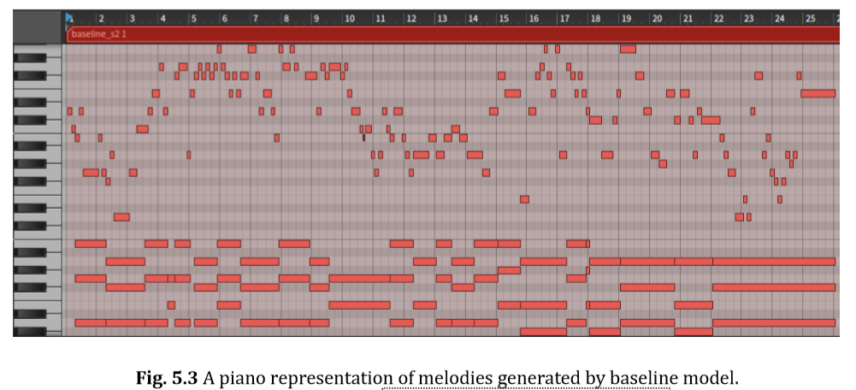
Baseline model
https://youtu.be/wbS6HRJ5EHA

Slide 26
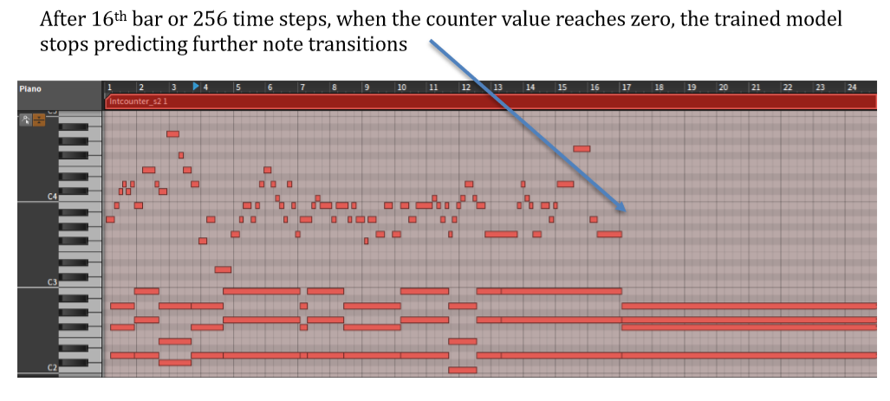
Impact of song duration counter
https://youtu.be/-eFNzjpNpEA
https://youtu.be/CQOCM-SgzNs

Slide 27
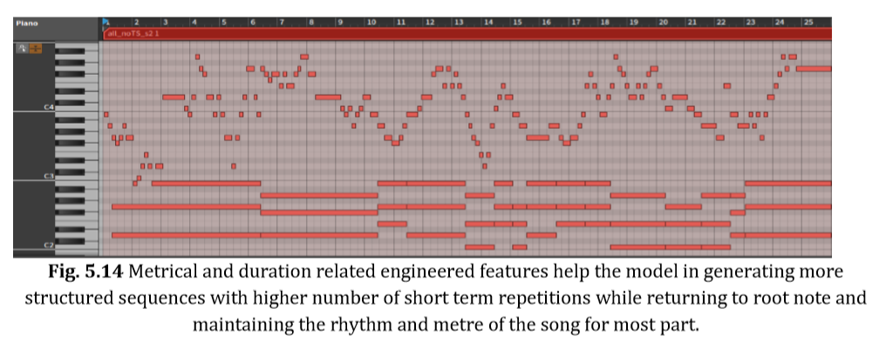
Impact of Metrical Counter
https://youtu.be/JQtG72ymfS8

Slide 28
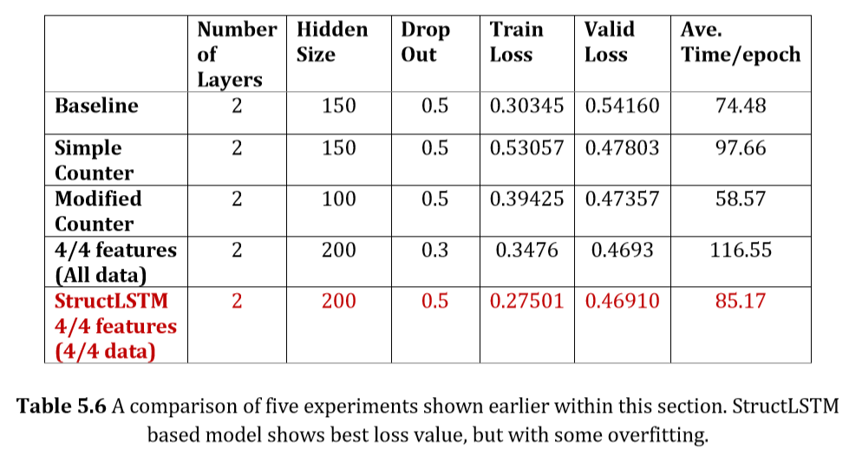
Final Results

